Slide 1
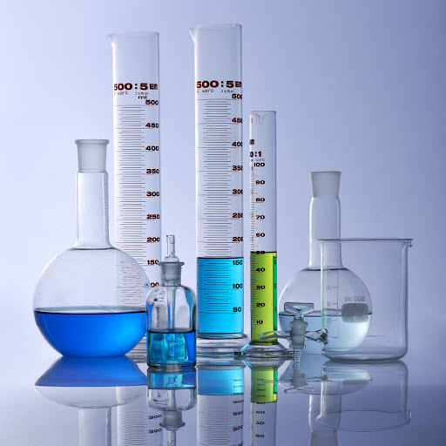
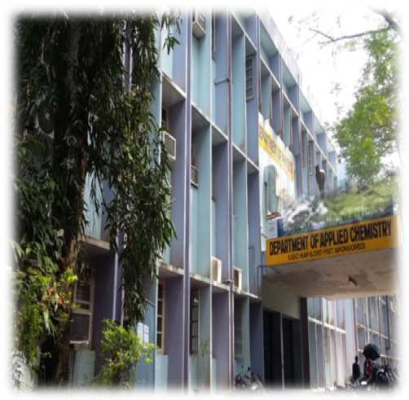
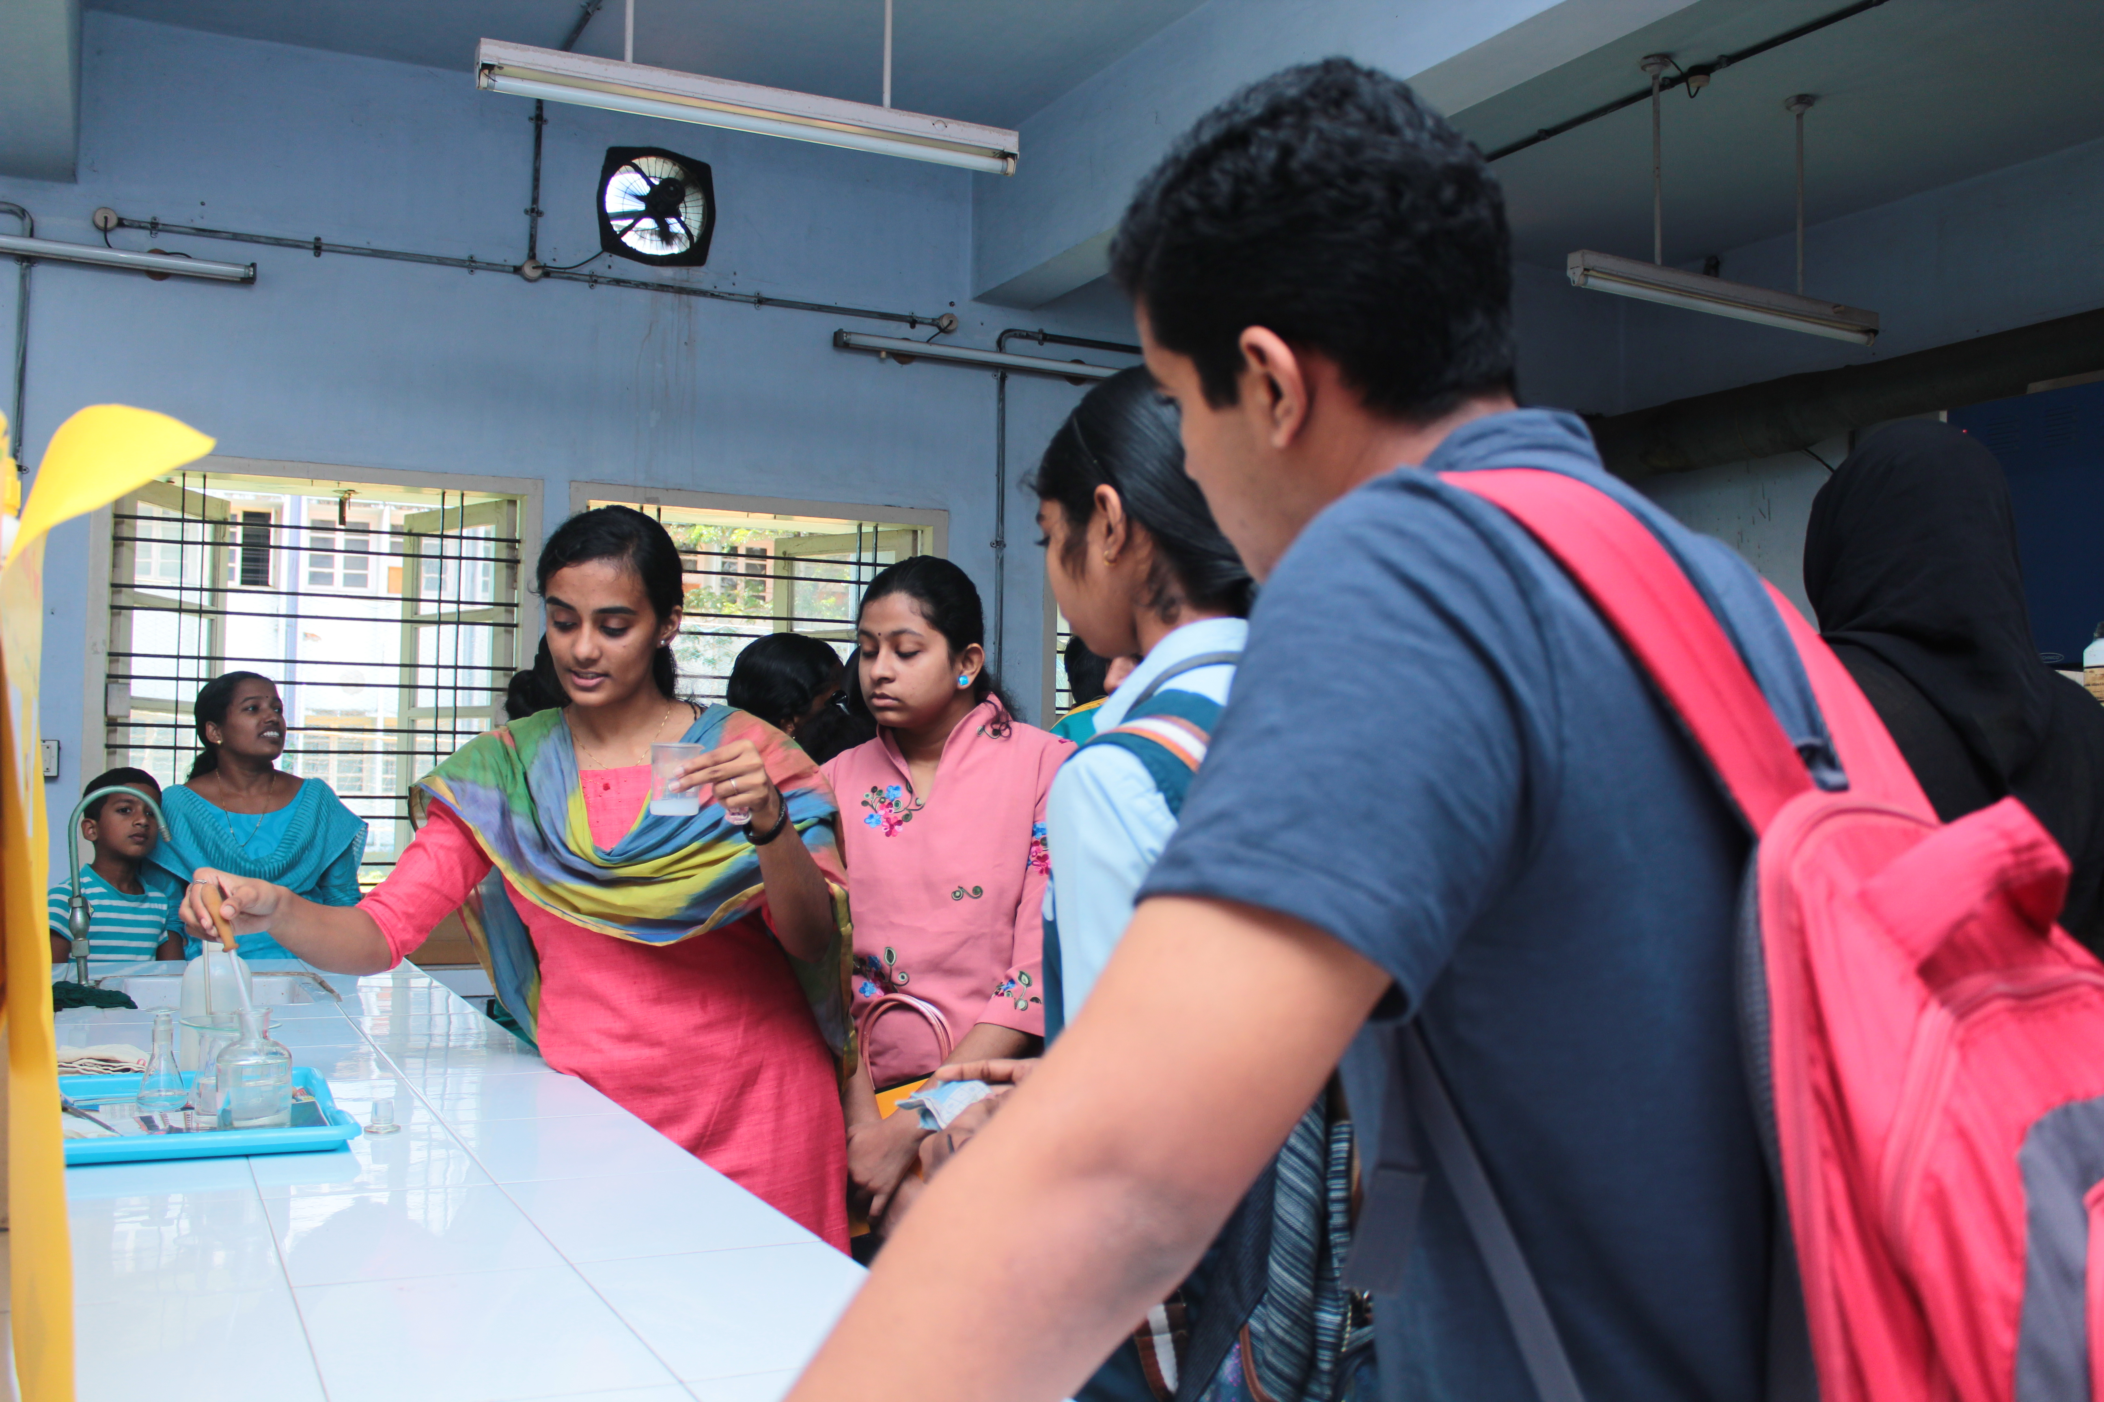
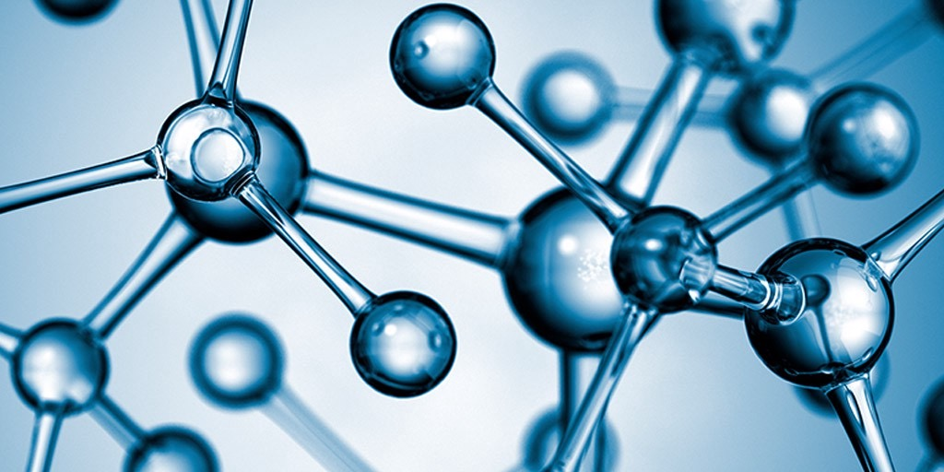

DEPARTMENT OF APPLIED CHEMISTRY
CUSAT

Slide 2
Department at a glance
The Department of Applied Chemistry was established in 1976 with the support of UGC. Throughout the last few decades, the Department has embraced its challenging role in the further development of the industrial belt in the Greater Cochin area by providing scientific support and trained personnel to the industries. Department has always been keen to pave the path for high quality education ensuring best career opportunities for the students. The Department is steadfast in its resolve to inculcate a spirit of learning and social skills in the students, to kindle creative ideas and to equip them to face the future challenges in an enthusiastic manner.
Our Vision:
To create a world-class teaching and research institution which can provide a rich opportunity and scientific platform for innovation, excellence and discovery, and attract the best students and staff worldwide.
Courses offered:
M.Sc. Chemistry
The programme with a current intake of 24 is one of the most sought of courses in the University as evident from the high demand ratio. The selection of students is based on a Common Admission Test conducted by the University.
The programme is designed with an outcome- based syllabus which ensures that the students assimilate the subject in totality and can take it to further levels of application and creativity wherever required. Development of practical and analytical skills in students is also a high priority . The fourth semester is entirely dedicated to project work and the students are highly benefitted by the opportunity to do the four months of project work in institutes of national repute.
Ph.D.
Our doctoral research programs are designed to provide researchers a deep understanding and pique their curiosity into uncharted scientific horizons. Interested candidates who have finished their Masters in Chemistry can apply to various labs directly if they have secured fellowships from national level screening test or by qualifying the departmental admission test.

Slide 3
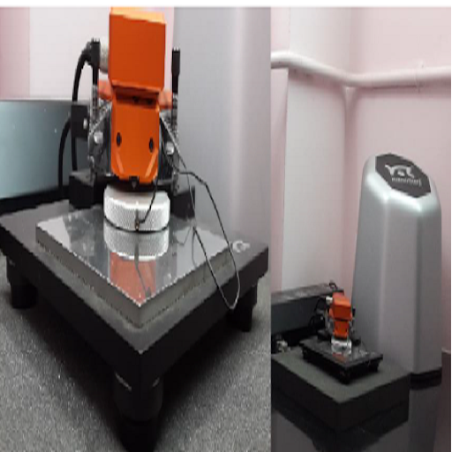
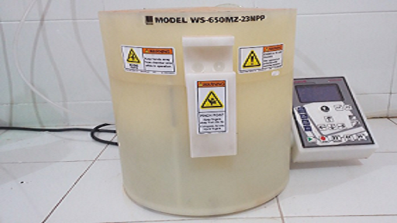
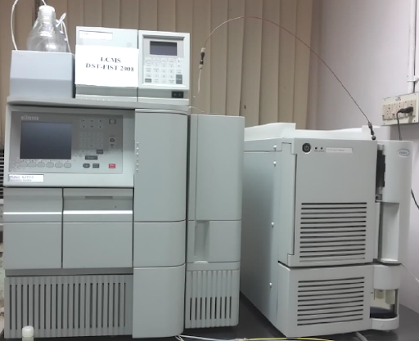
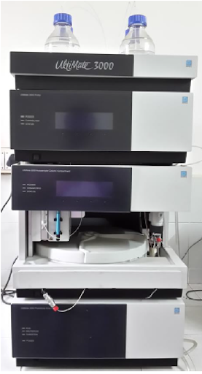
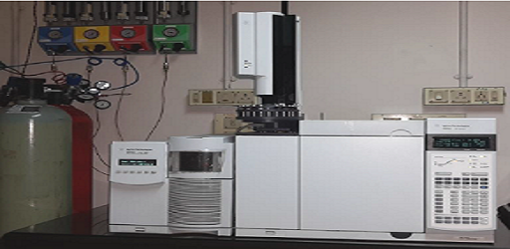
Research in the Department
The department has several ongoing national and international projects and collaborations to ensure cutting edge research and a circuit of knowledge and resource including student exchange programmes.
Instrumental Facilities
The department houses various high end instruments to ensure quality research and enable our graduate students to get hands own training to operate analytical Instruments like UV visible Spectrophotometer, FTIR, etc. during their practical sessions. The various facilities available in our department are:
UV-Visible Spectrophotometer
FT-IR
TG-DTA
HPLC
Gouy Balance
GCMS, FID, TCD
AFM-STM
Solar simulator
Fibre optic portable fluorescence spectrometer
Electrochemical work station
UTM
GPC
Fluorescence spectrometer TCSPC Lifetime systems
GC
Fluorescence spectrometer
Flash Chromatography System

Slide 4
Areas of research
Analytical Chemistry and Sensors
Polymer chemistry &
Technology
Catalysis
Computational Chemistry
Inorganic Chemistry
DEPARTMENT OF APPLIED CHEMISTRY
COCHIN UNIVERSITY OF SCIENCE AND TECHNOLOGY
KALAMASSERY, KOCHI-22
Phone : 0484 286 2420, 0484 257 5804
Email : chem@cusat.ac.in
Web. : chem.cusat.ac.in

